Slide 1
Unit 2
Markets for Information Goods

Slide 2
Introduction to Information Economy
An economy based on the effective acquisition, dissemination, and use of information, rather than on the means of production.

Slide 3
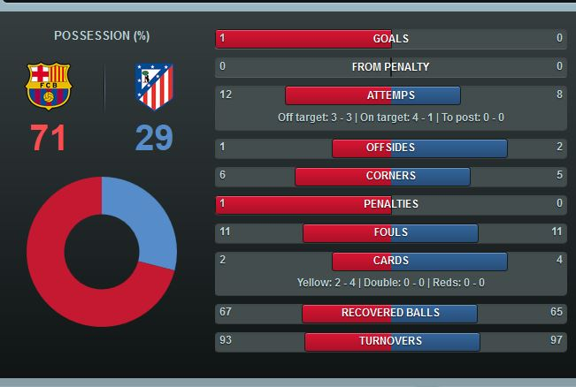
Information Good
Anything that can be digitized-encoded as a stream of bits-is information.
Examples: Sports Scores, books, databases, magazines, movies, music, NEPSE
Business value and Entertainment value

Slide 4
Cost of Producing Information
Information is costly to produce but cheap to reproduce.
High fixed costs but low marginal cost.
Price information according to its value not its cost.
Example: Books, CD’s, Microsoft Office

Slide 5
Managing Intellectual Property
Cheaply reproduce cause copying cheaply.
Legal grants of exclusive rights to intellectual property via patents, copyright, and trademarks.
Example: Video Industry.

Slide 6
Information as Experience Goods
Every new product is an experience good.
How do you know weather today’s Wall Street Journal is worth 75 cent s until you’ve read it?

Slide 7
Economic and Public Goods
non-Rivalrous and non-Excludable.
Examples: Police force, Air conditioning in cafe, Public Parks, Water Supply.
Free Rider Problem

Slide 8
The Economics of Attention
Availability of information quickly and inexpensively.
A wealth of information creates a poverty of attention.

Slide 9
Technology
Search
The Technology infrastructure makes information more accessible and hence more valuable.
Store
Retrieve
Transmit

Slide 10
Systems Competition
Many products have little or no value in isolation, but generate value when combined with others. Examples include: nuts and bolts,
Focuses not just on your competitors but also on your collaborators and complementors.

Slide 11
Lock-in and Switching Costs
customer lock-in, makes a customer dependent on a vendor for products and services, unable to use another vendor without substantial switching costs.
Example: Apples itunes, Printer Manufacturer, Hotel room booking.

Slide 12

Positive Feedback
Positive feedback makes
large networks get larger

Slide 13
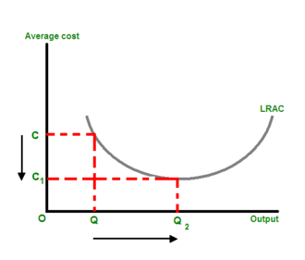
Sources of Positive Feedback
• Supply side economies of scale
– Declining average cost
– Marginal cost less than average cost
– Example: information goods, early US car industry
• Demand side economies of scale
– Network effects
– In general: fax, email, Web
– In particular: Sony v. Beta, Wintel v. Apple

Slide 14
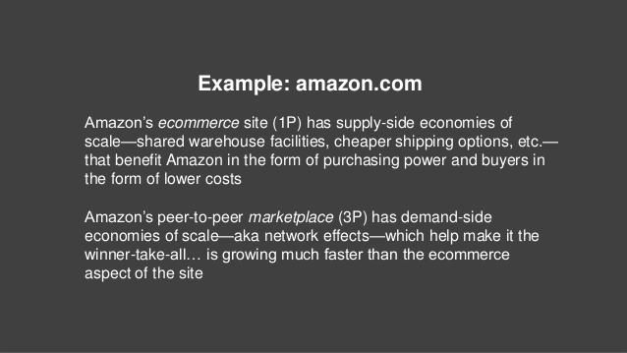

Slide 15
Network Externalities
Network effects lead to demand side economics of scale and positive feedback.

Slide 16

Standards
Agreed way of doing something.
Standards change competition for a market to competition within a market

Slide 17
Policy
Definite course or method of action selected from among alternatives and in light of given conditions to guide and determine present and future decisions

